Slide 1

CS-M151B
Computer Systems Architecture
Blaise Tine
UCLA Computer Science

Slide 2

Attendance

Slide 3
Agenda
RISC-V Pipelined Architecture
Project #1

Slide 4
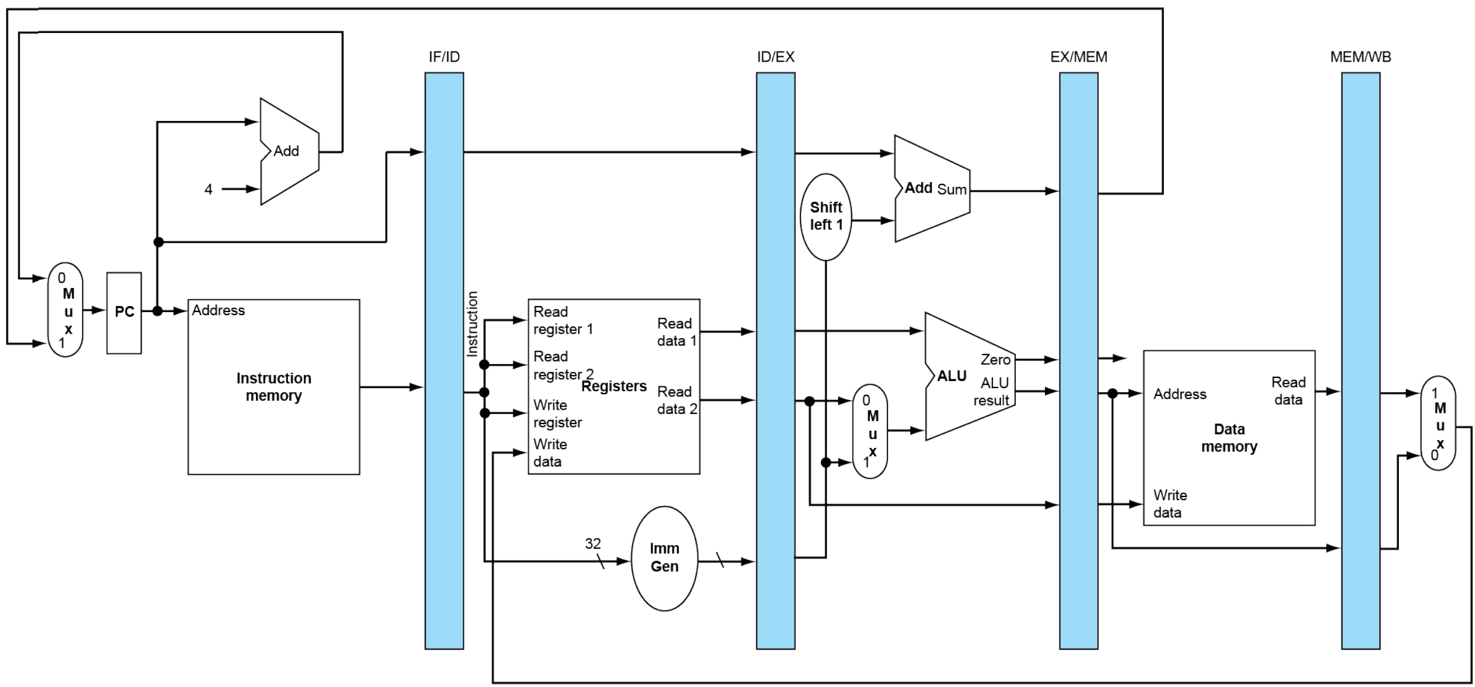
5-Stage Pipeline RISC-V Processor

Slide 5
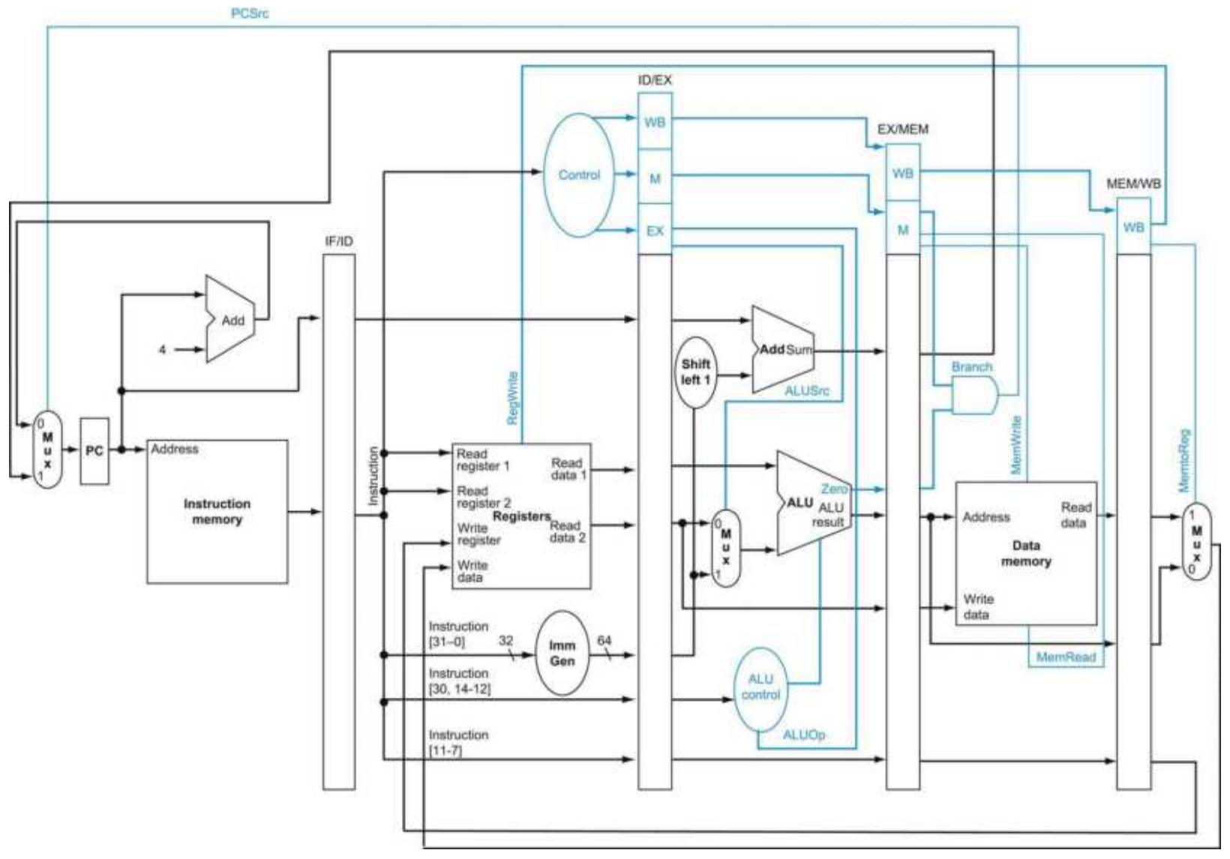
Basic RISC-V CPU Control Path
Data Path
Control Path

Slide 6
Exercise: Single-Cycle vs Pipeline
Calculate cycle time (CT)
Unit | Latency (ps)
Instruction Fetch | 400
Register Access | 300
ALU | 200
Memory Access | 400

Slide 7
Exercise: Single-Cycle vs Pipeline
Single-Cycle Datapath
Instr | Data Path
R/I-type | IF+RR+ALU+RW
LW | IF+RR+ALU+MR+RW
SW | IF+RR+ALU+MW
BEQ | IF+RR+ALU

Slide 8
Exercise: Single-Cycle vs Pipeline
Single-Cycle Datapath
Instr | Data Path | Cycle Time | Total Time
R/I-type | IF+RR+ALU+RW | 400+300+200+300 | 1200 ps
LW | IF+RR+ALU+MR+RW | 400+300+200+400+300 | 1600 ps
SW | IF+RR+ALU+MW | 400+300+200+400 | 1300 ps
BEQ | IF+RR+ALU | 400+300+200 | 900 ps

Slide 9
Exercise: Single-Cycle vs Pipeline
Pipeline Datapath
Instr | Data Path | Cycle Time | Total Time
R/I-type | IF|RR|ALU|RW | Max(400,300,200,300) | 400 ps
LW | IF|RR|ALU|MR|RW | Max(400,300,200,400,300) | 400 ps
SW | IF|RR|ALU|MW | Max(400,300,200,400) | 400 ps
BEQ | IF|RR|ALU | Max(400,300,200) | 400 ps

Slide 10
Pipeline Hazards
Consider this scenario:
I0: add x5, x1, x2
I1: sub x20, x5, x4
Source registers:
I0: x1, x2
I1: x5, x4
Destination registers:
I0: x5
I1: x20

Slide 11
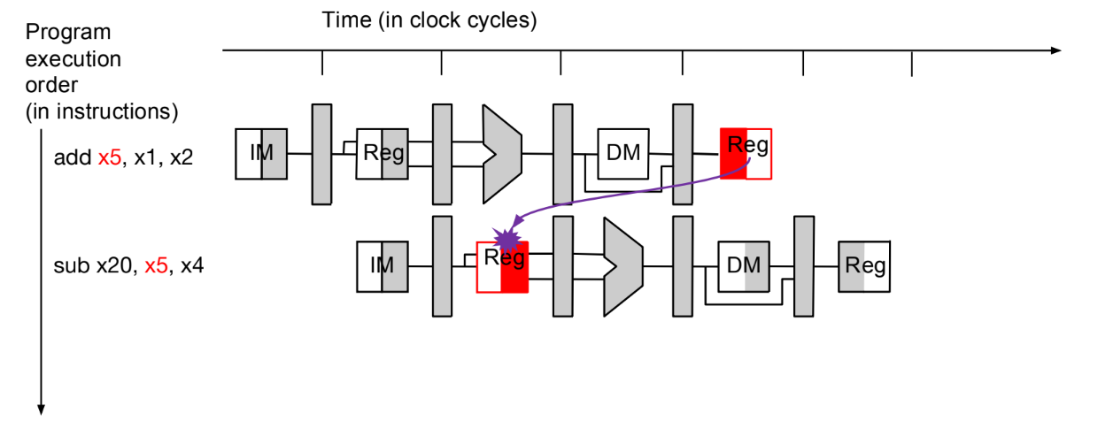
Pipeline Hazards
Register dependency:
X5’s result is not ready for I1
Should we care?

Slide 12
Pipeline Hazards
Programmer expects instructions ordering:
To get expected result
I0: add x5, x1, x2
I1: sub x20, x5, x4

Slide 13
Pipeline Hazards
Should the processor enforce instructions ordering?
Only externally
Memory is visible to S/W
Registers are visible to S/W (e.g. debugger)
Can do any optimization it wants internally

Slide 14
Pipeline Hazards
What’s a pipeline hazard?
Resource sharing conflict inside the pipeline
Pipelining introduces resource sharing between instructions
Register file
Execution units

Slide 15
Pipeline Hazards
Types of pipeline hazard
Control hazard
Structural hazard
Data hazard

Slide 16
Control Hazards
Control-flow dependency between instructions
Target address or condition not yet available to a branch instruction

Slide 17
Structural Hazards
Resource sharing between instructions
Prior instruction still using a resource that current instruction need
e.g. Multi-cycle integer divider unit

Slide 18
Data Hazards
Register sharing between instructions
Operands are not yet available to an instruction
Because prior instruction has not yet produced result

Slide 19
Data Hazards
Types of data Hazards
Read after write (RAW)
Write after write (WAW)
Write after read (WAR)
Read after read (RAR)

Slide 20
Data Hazards: RAW
Reading a register before its write completes
Example:
I0: add x5, x1, x2
I1: sub x20, x5, x4

Slide 21
Data Hazards: RAW
How many cycles should I1 stall?
I0: add x5, x1, x2
I1: sub x20, x5, x4
Notes:
Solution: 2 cycles

Slide 22
Data Hazards: WAW
Writing to a register before its write completes
Example:
I0: add x5, x1, x2
I1: sub x5, x3, x4
Is it a dependency issue?

Slide 23
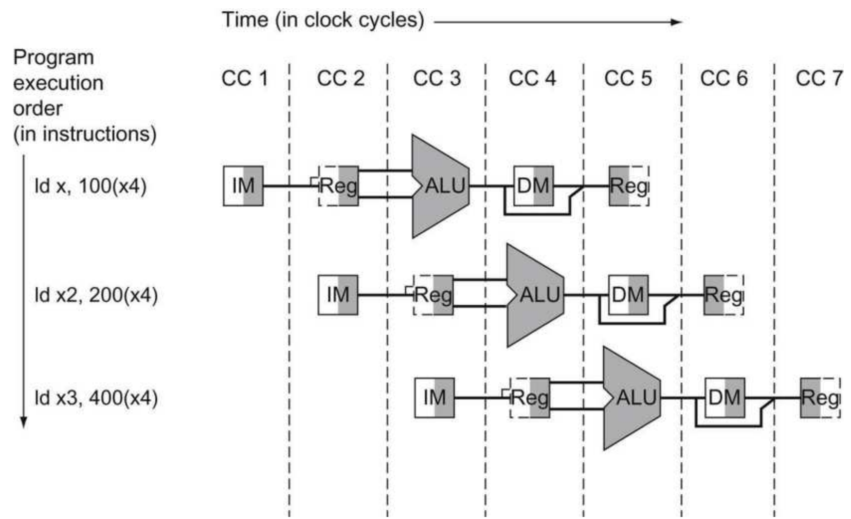
Data Hazards: WAW
I1 will update x5 after I0
I0: add x5, x1, x2
I1: sub x5, x3, x4
I0
I1
I2

Slide 24
Data Hazards: WAW
WAW is not an issue here
Due to in-order program execution
Problematic if out of order execution

Slide 25
Data Hazards: WAR
Writing to a register before it is read
Example:
I0: add x2, x1, x5
I1: sub x5, x3, x4
Is it a dependency issue?

Slide 26
Data Hazards: WAR
I1 will update x5 after I0
I0: add x2, x1, x5
I1: sub x5, x3, x4
I0
I1
I2

Slide 27
Data Hazards: WAR
WAR is not an issue here
Due to in-order program execution
Problematic if out of order execution

Slide 28
Data Hazards: RAR
Reading from a register before it is read
Example:
I0: add x2, x1, x5
I1: sub x20, x5, x4
Is it a dependency issue?

Slide 29
Data Hazards: RAR
No dependency issue
We are only reading

Slide 30
Resolving RAW hazards
Naïve approach:
We stall the pipeline!
Wait until the register value is ready

Slide 31
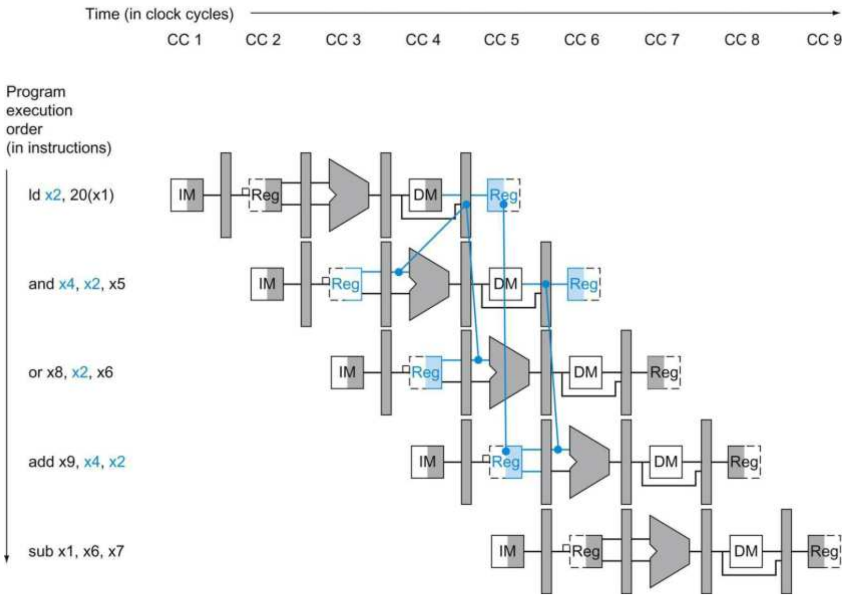
Resolving RAW hazards
Example1:
RAW?
x2

Slide 32
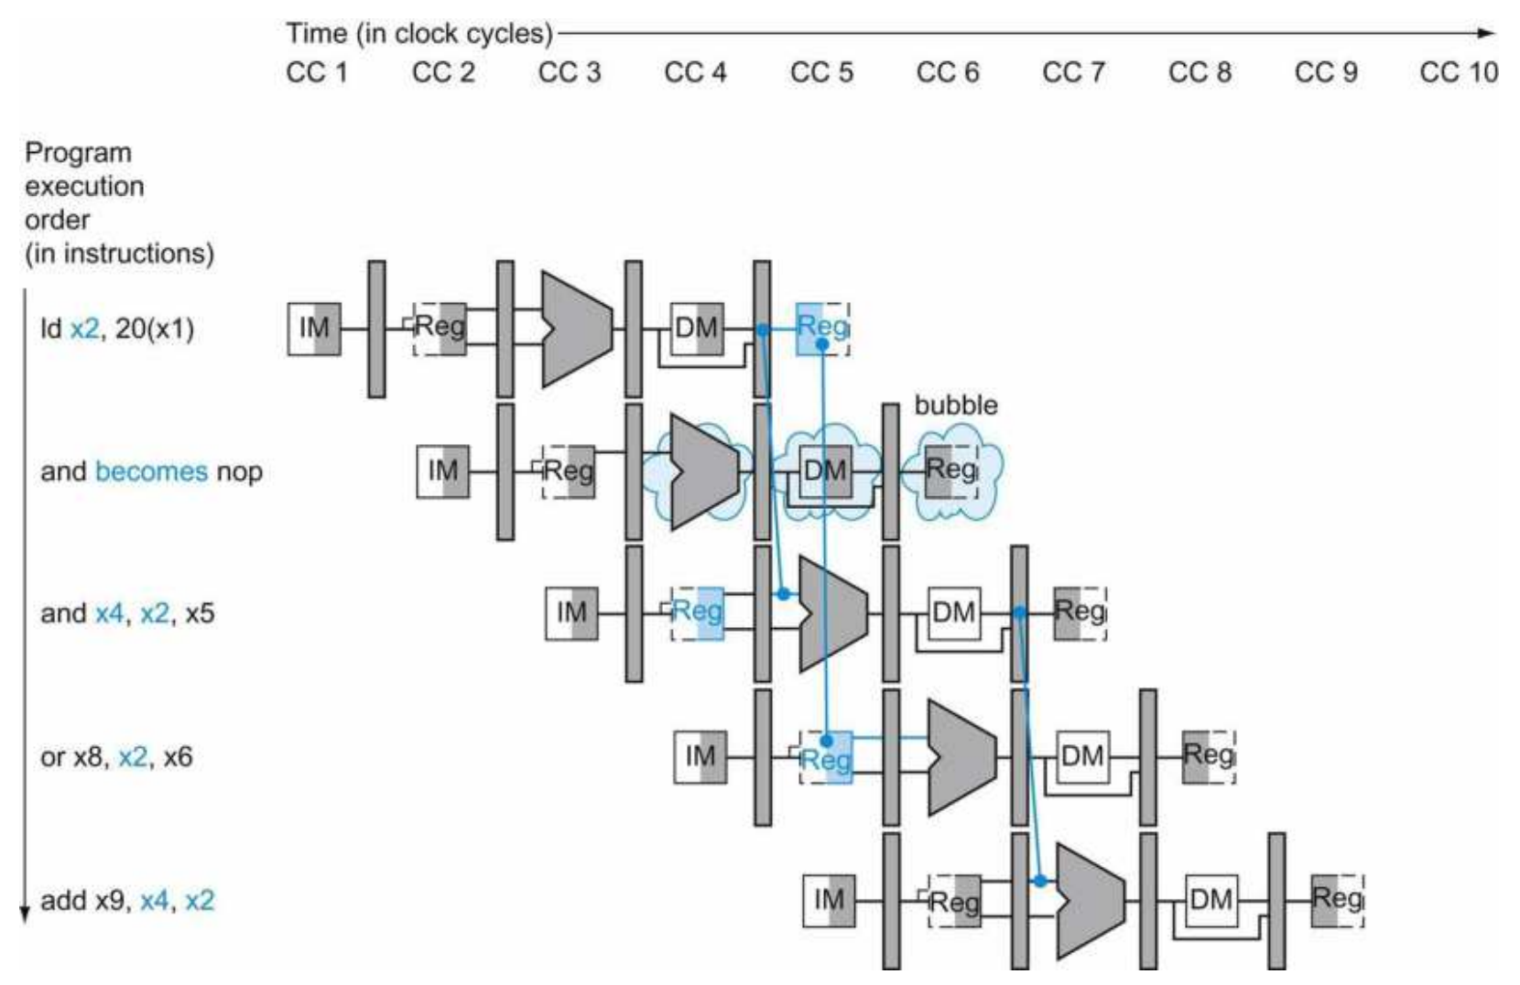
Resolving RAW hazards
Solution1:
Insert 1 bubble
Or NOP

Slide 33
Resolving RAW hazards
Example2:
I0: add x5, x1, x2
I1: sub x20, x5, x4

Slide 34
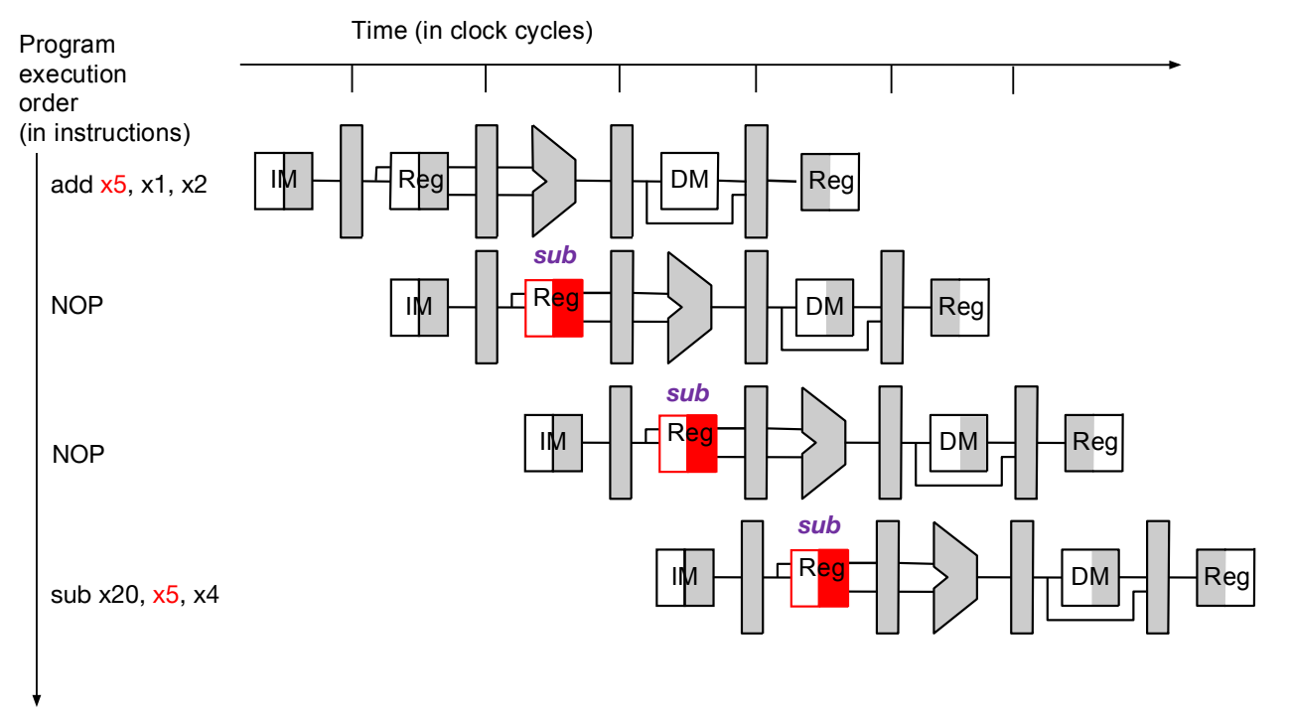
Resolving RAW hazards
Solution2:
Insert 2 bubbles
Or 2 NOPs

Slide 35
Resolving RAW hazards
Better Solution:
Stalls hurt pipeline performance
How to prevent stalls?
Use Data Forwarding instead

Slide 36
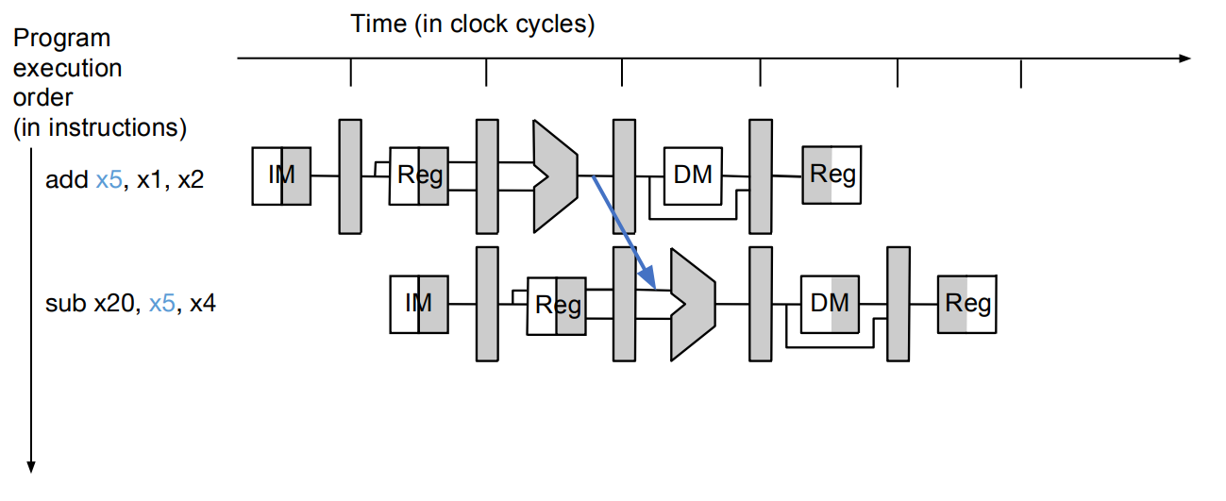
Resolving RAW hazards
Data forwarding:
Redirect computed result directly to ALU

Slide 37
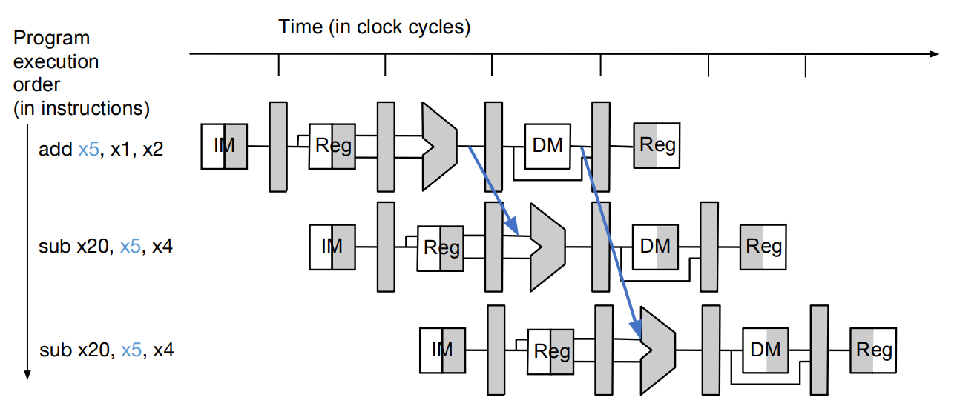
Resolving RAW hazards
Data forwarding:
Will need two forwarding paths
Any disadvantage?

Slide 38
Resolving RAW hazards
Data forwarding: Cost
Need extra wiring
Need multiplex to choose ALU source
Propagation delay may increase

Slide 39
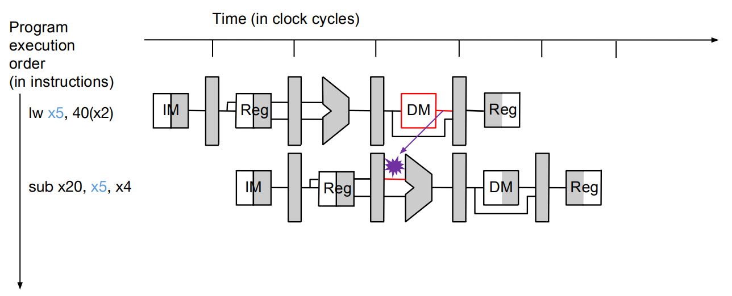
Resolving RAW hazards
Data forwarding: Memory-ALU
Load-Use propagation cost
Not practical

Slide 40
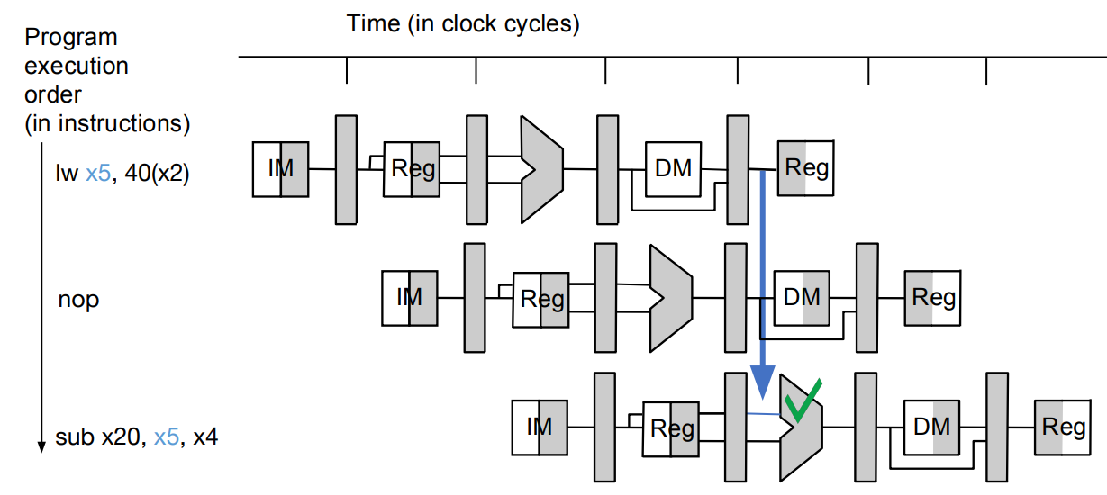
Resolving RAW hazards
Data forwarding: Memory-ALU
Do one-step forwarding instead of two
Add one bubble

Slide 41
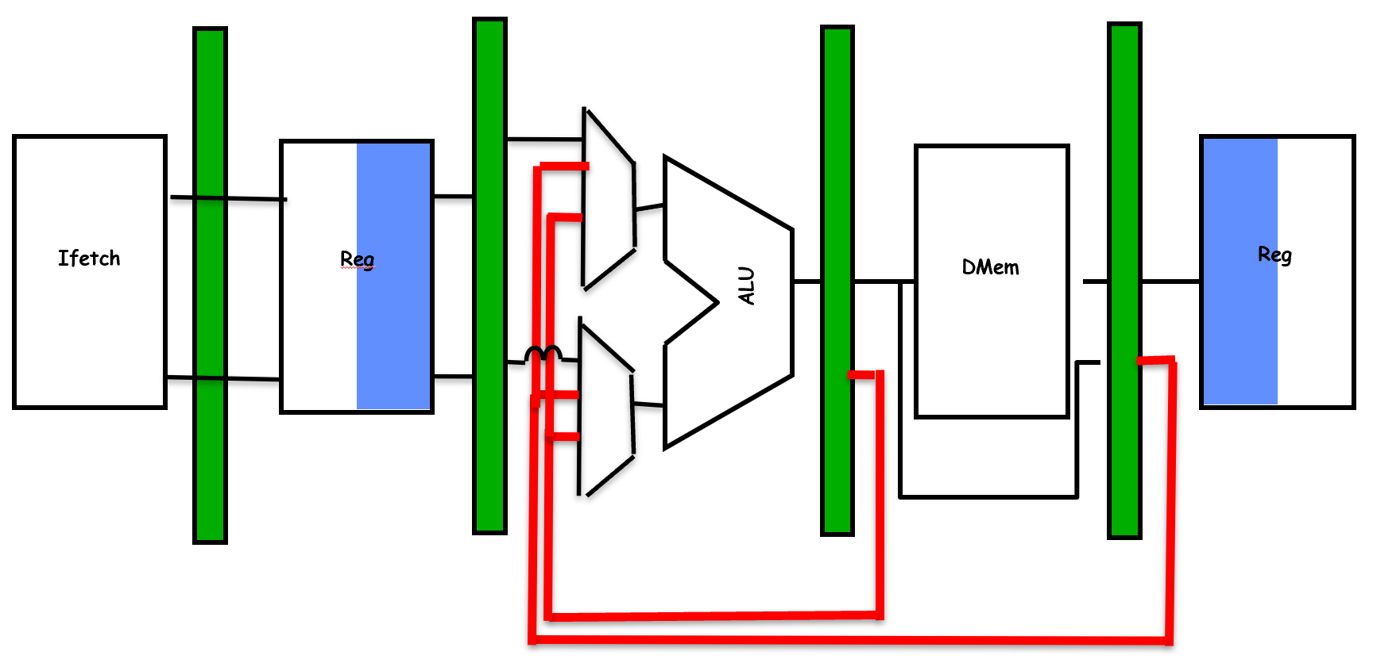
Resolving RAW hazards
Data forwarding: design1
Insert MUXs before ALU

Slide 42
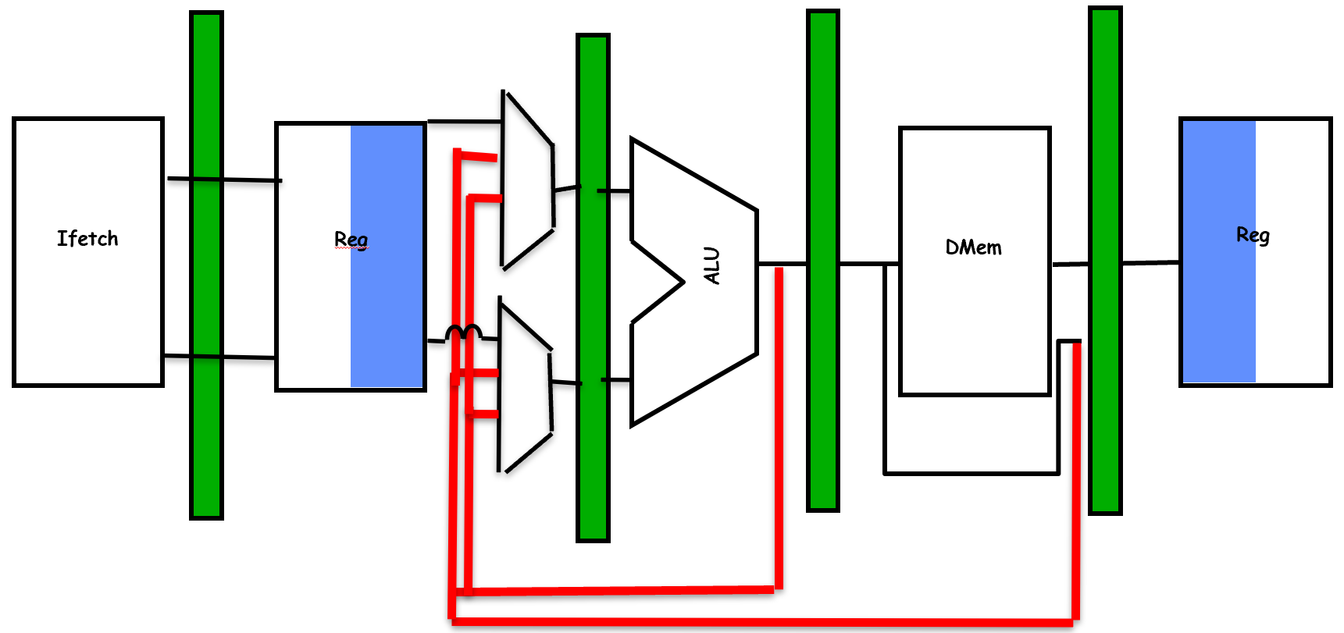
Resolving RAW hazards
Data forwarding: design2
Insert MUXs before register

Slide 43
Resolving RAW hazards
Data forwarding: which design is better?
The one with shorter propagation delay
Register File extension vs ALU extension
Design1
Design2

Slide 44
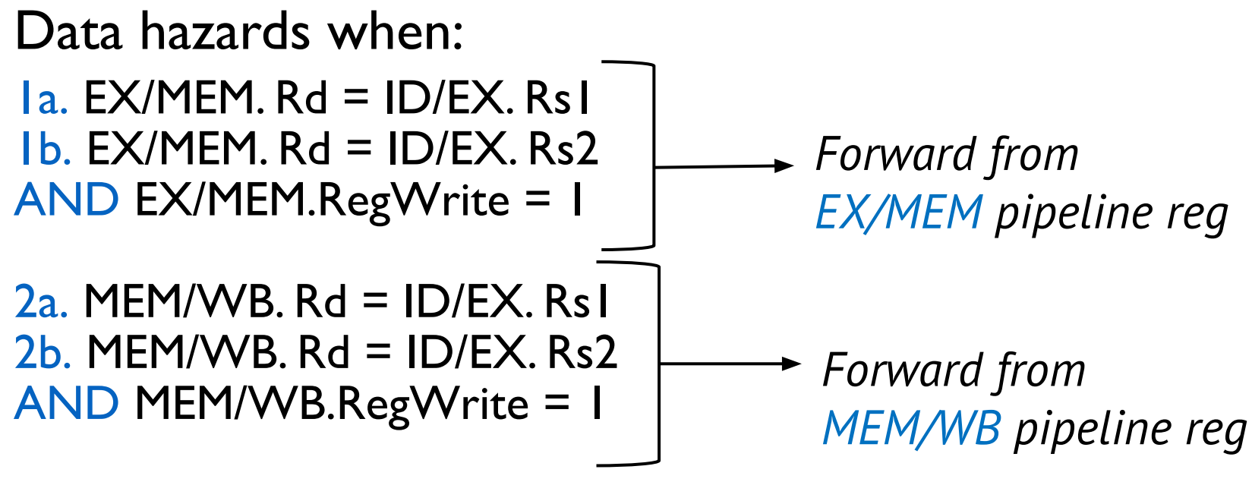
Resolving RAW hazards
Data forwarding: detect RAW forwarding?

Slide 45
Project #1
Context:
Partial implementation of a RISC-V CPU in C++
RISC-V RV32-I specs
RISC-V conformance tests
Decoder incomplete
No data forwarding
No control forwarding

Slide 46
Project #1
CPU Architecture:
Emulator: generate instruction trace
Cycle-level simulator: generate instruction timing

Slide 47
Project #1
To implement:
Instruction encoding
Data forwarding
Control forwarding

Slide 48
Project #1
Evaluation:
Program compiles: 5 pts
All tests passed: 5pts
Timing is correct: 5 pts

